Slide 1
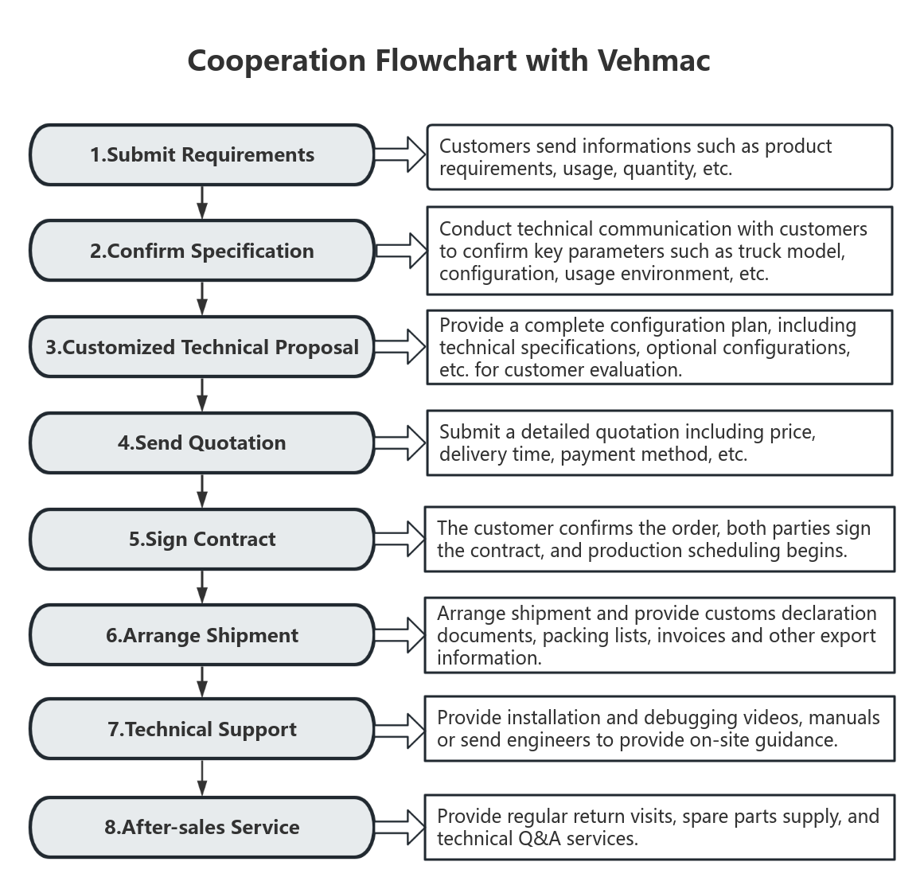

WhatsApp:+86 15146288308

